Slide 1
Theory of Consumer Behavior

Slide 2
Theory of Consumer Behavior
Explains how a consumer gets maximum satisfaction by allocating his limited income to various available commodities.
Explains the consumer’s equilibrium which is equal to maximum satisfaction.
Provide an answer to the question:
How does a consumer decide the optimum quantity of goods?
How much to spend on a particular commodity?

Slide 3
Concept of UTILITY
Usefulness.
Want satisfying power of goods.
May differ from person to person.

Slide 4
Approaches of UTILITY Analysis
Cardinal Approach
Can be measured in numbers like 1,2 etc.
Traditional concept
Measured in “utils”
H.H.Gossen and Alfred Marshall
Ordinal Approach
Can’t be measured in numbers like 1,2 etc.
Can be ranked in order
Modern concept
John R Hicks

Slide 5
Ordinal Utility Analysis
Indifference Curve Analysis (IC)
Hicksian Approach
This concept was introduced by Francis Y. Edgeworth and later popularized by John R. Hicks.
This concept evolved on the ground that utility can’t be expressed in quantitative terms.
It believes that Utility is a subjective phenomenon, and can be ranked and put in order only.

Slide 6
Ordinal Utility Analysis
The concept of Ordinal Utility is based on;
It is not possible for a consumer to express his utility in quantitative terms. But it is always possible for him to tell which of any two goods s/he prefers. E.g., an individual may not be able to specify how much utility s/he derives by eating a mango. But he can tell what s/he prefers between mango and apple.
A consumer can list all commodities he consumes in the order of his preference.

Slide 7
Assumptions of Ordinal Analysis:
Rational consumer.
Must try to maximize the utility given the money.
Full knowledge.
Ordinal measurement of utility.
Non Satiety:
It means that the consumer has not reached the point of saturation in the case of any commodity initially.
Diminishing Marginal Rate of substitution
The MRS is the rate at which a consumer is willing to substitute one good for the other so that the total level of satisfaction remains the same. It is always decreasing.
Transitivity and consistency of choice:

Slide 8
Transitivity of Choice:
Consumer’s choices are assumed to be transitive. Transitivity of choice means that if a consumer prefers A to B and B to C, he must prefer A to C.
Symbolically,
If A>B and B>C, then A>C.
Consistency of choice:
It is assumed that a consumer is consistent in his choice, which implies that if the consumer prefers A to B in one period, he must not prefer B to A in another period.
Symbolically,
If A>B in one period, then B Not> A another time.

Slide 9
Indifference Curve(IC)
An Indifference curve is the locus of all those combinations of two goods which yields the equal level of satisfaction to consumer.
It explains consumer’s behavior in terms of his/her preferences of ranking for different combination of two goods.
Iso-Utility curve, Equal Utility curve.
A tool for ordinal approach of utility analysis.
One commodity serves as a substitute for another. It provides an opportunity to substitute one for another. Therefore, a consumer can make various combinations of two goods which give him/her same level of satisfaction. When such combinations are tabulated its called IC schedule and when plotted in graph becomes IC.

Slide 10
Indifference Schedule:
An indifference schedule is defined as the tabular presentation of various combinations of two goods providing the same level of satisfaction to the consumer. Let us suppose that a consumer consumes two goods X and Y. Then, a hypothetical indifference schedule can be presented as follows.
Combination | X-goods | Y-goods
A | 1 | 14
B | 2 | 10
C | 3 | 7
D | 4 | 5
E | 5 | 4

Slide 11
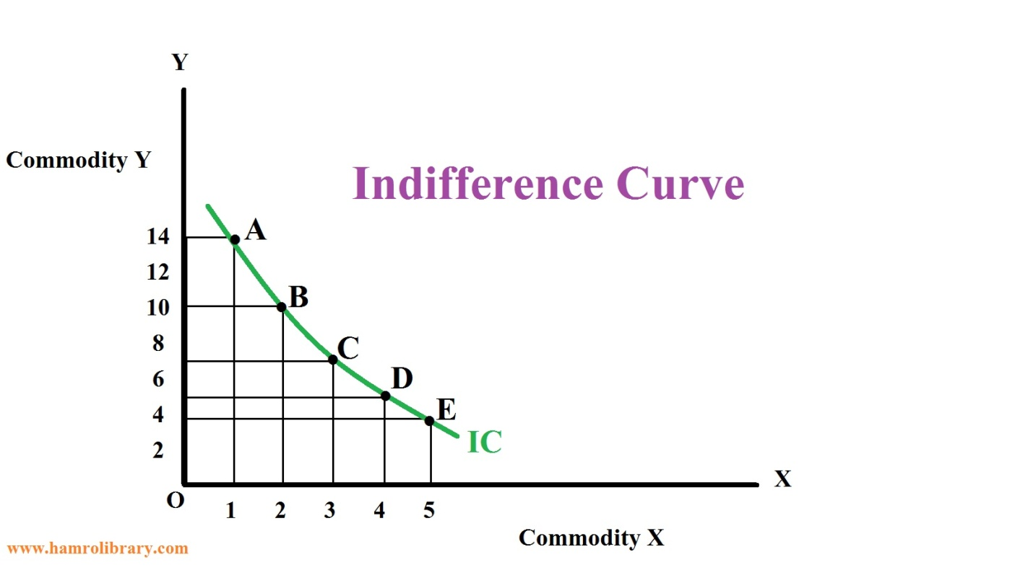
Indifference Curve(IC)
Since, all the combination on the indifference curve yield same level of satisfaction, the consumer remains indifferent in choosing any combination among available combinations.

Slide 12
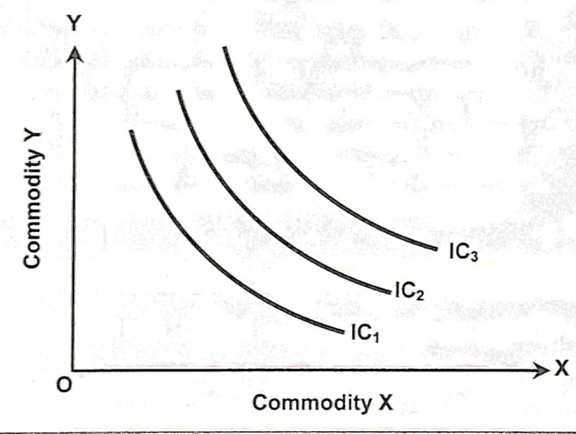
Indifference Curve
When the indifference schedule is plotted in the graph we will get the indifference curve as shown in the figure.
Indifference Map
A set of indifference curves is called an indifference map. An indifference map shows different indifference curves that rank the preferences of the consumer.

Slide 13

Properties of IC
Always downward sloping and convex to the origin.
Indifference curve has a negative slope
Negative slope implies that the two goods are substitutes for one another.
Therefore, if the quantity of one commodity decreases, the quantity of the other commodity must increase to stay at same level of satisfaction.C

Slide 14

Properties of IC
2. Higher IC gives higher level of satisfaction.
A higher IC represents higher level of satisfaction than the lower IC. The reason is that an upper IC contains larger quantity of one of both the goods than the lower one.

Slide 15
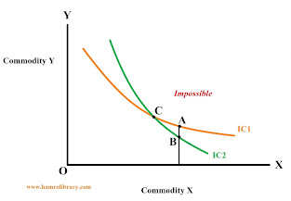
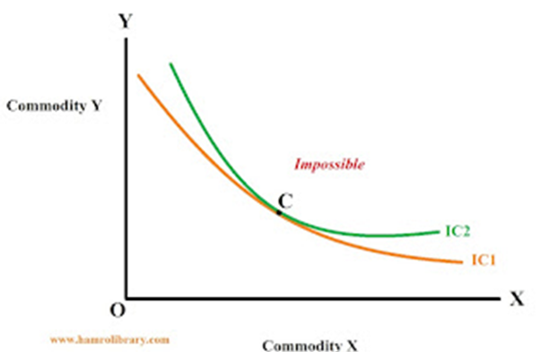
Properties of IC
3. Indifference curves neither Intersect nor become tangent to one another:
If two indifference curves intersect or are tangent to each other, it means that an indifference curve indicates two different levels of satisfaction. If two indifference curves intersect, it violates consistency or transitivity assumption.

Slide 16
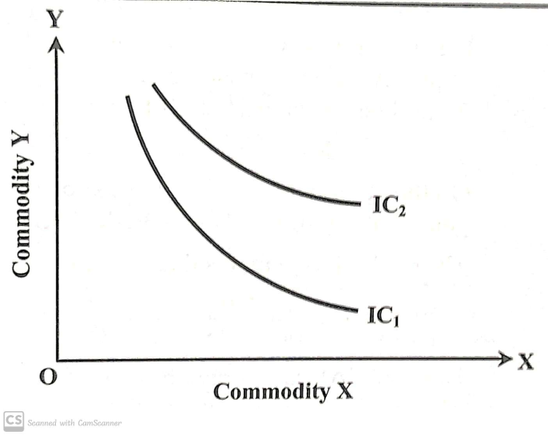
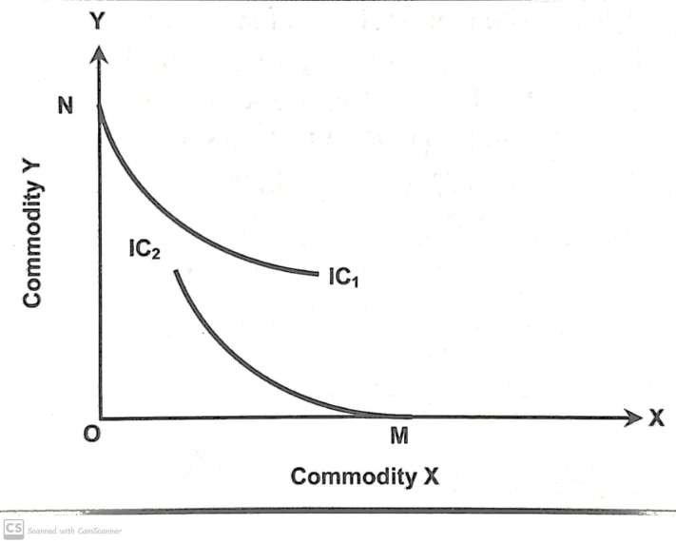
Properties of IC
4. ICs are not necessarily parallel.
5. IC does not touch either of the axis.

Slide 17
Marginal Rate of substitution
Diminishing Marginal Rate of Substitution.
It is the rate at which one good can be substituted for another without affecting total satisfaction.
The diminishing marginal rate of substitution (MRS) refers to the rate at which a person is willing to trade off one good for another while keeping the same level of utility.
In other words, it measures the amount of one good that a person is willing to give up to obtain more of another good while maintaining the same level of overall satisfaction or utility.
Slope of IC.

Slide 18

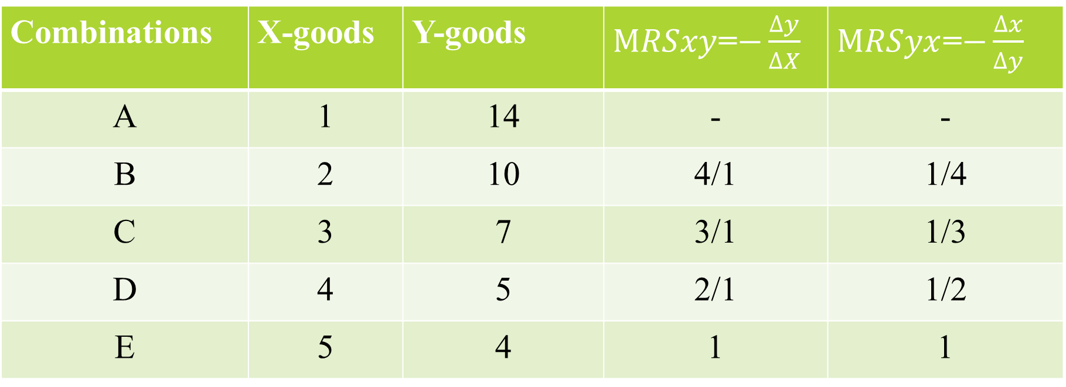
Symbolically,
$MRSxy=−\frac{∆y}{∆X}=\frac{MUx}{MUy}$ [X substituted for Y]
$MRSyx=−\frac{∆x}{∆y}=\frac{MUy}{MUx}$ [Y substituted for X]
Combinations | X-goods | Y-goods | $MRSxy$=$−\frac{∆y}{∆X}$ | $MRSyx$=$−\frac{∆x}{∆y}$
A | 1 | 14 | - | -
B | 2 | 10 | 4/1 | 1/4
C | 3 | 7 | 3/1 | 1/3
D | 4 | 5 | 2/1 | 1/2
E | 5 | 4 | 1 | 1

Slide 19

Marginal Rate of Substitution (MRS)
The rate at which one good is substituted for another without affecting the total level of satisfaction is the marginal rate of substitution. The MRS is given by the slope of IC.
Let the utility function be, U=f(x ,y) where X and Y are substitutes
Also, suppose the consumer substitutes X for Y without affecting the level of satisfaction.
So, his loss of utility can be expressed as, $[−∆Y.{MU}_{y}]$
His gain of utility can be expressed as, $[+∆X.{MU}_{x}]$
Since the total utility remains the same. So,
$$−∆Y.{MU}_{y}=+∆X.{MU}_{x}$$
On Solving; [X substituted for Y] ${MRS}_{xy}=−\frac{∆Y}{∆X}=\frac{{MU}_{x}}{{MU}_{y}}$
Likewise; [Y substituted for X] ${MRS}_{yx}=−\frac{∆X}{∆Y}=\frac{{MU}_{y}}{{MU}_{x}}$

Slide 20
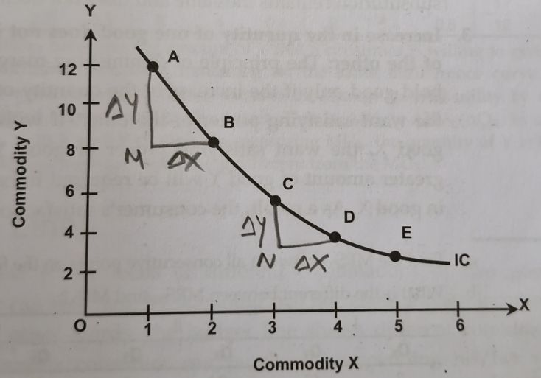
When the consumer moves from A to B, he is ready to give up 4 units of Y to add up 1 unit of X. In the process, his level of satisfaction level remains the same.

Slide 21

Budget Line(Price Line)
Budget line is the locus of different combinations of two goods which a consumer can purchase by spending his/her income with given prices.
It can be represented by a budget equation;
$Px×Qx+Py×Qy=M$…………(i)
Assumptions:
Consumer consumes two goods (should be purchased).
Consumer has to pay for the goods.
A consumer has a limited budget.

Slide 22
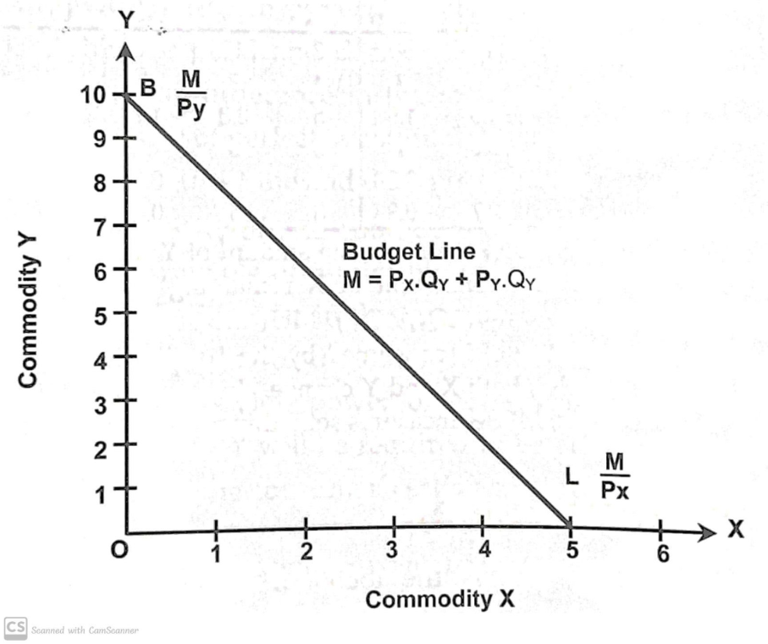

The slope of Budget line
Slope =$−\frac{Y−intercept}{X−intercept}$
$=−\frac{OB}{OL} =−\frac{Px}{Py}$

Slide 23
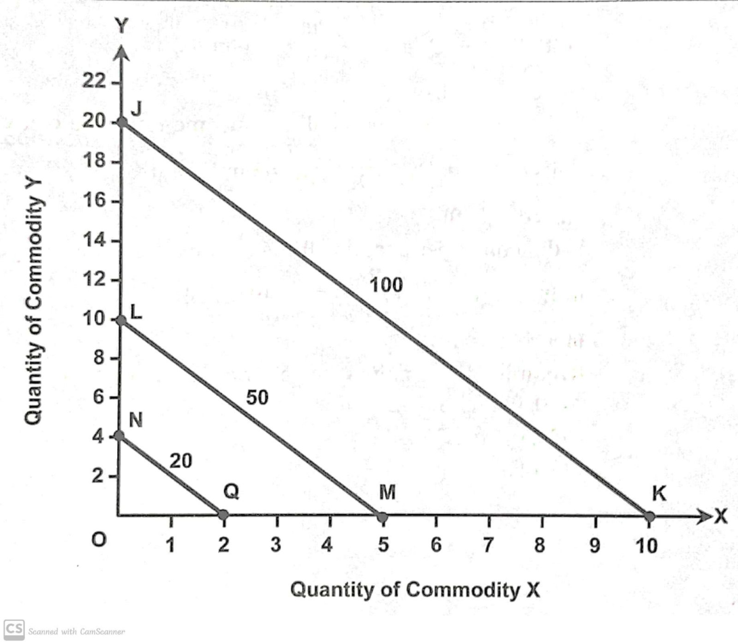
Shift in Budget Line
Shift is the process in changing the position.
Other this remaining constant, If budget increase, it shifts rightward.
And, if budget decrease, it shifts leftward.

Slide 24
Swing in Budget Line
Under Ceteris Paribus, when the price of the particular commodity changes, the budget line will swing upward or downward. If the price of the commodity decreases, the purchasing power of the consumer increases, which causes an upward swing in the price line. Similarly, when price increases, the purchasing capacity of a consumer decreases, which causes a downward swing in the price line.

Slide 25
If a consumer has money income of Rs.200 and price of X and Y goods are Rs.20 and Rs.10 respectively.,
Draw a price line.
If the price of X falls from Rs. 20 to Rs.10, what will be the position of price line. Show in the same graph.
If the price of X rises from Rs. 20 to Rs.25, what will be the position of price line. Show in the same graph.
Suppose a consumer has money income of Rs. 100 and Px and Py are Rs.10 and Rs.5 respectively and he spent all his income on X and Y.
Draw a price line.
Show in graph, if the income of the consumer increases to Rs.200
Also, if the income decrease by Rs.20.

Slide 26
Consumer’s Equilibrium
A consumer is said to be in equilibrium when s/he maximizes his/her utility or maximum satisfaction out of his/her given income in a given market prices of the goods and services .
Equilibrium is the point where consumer maximized the satisfaction by consuming two goods with given money income at given market prices.

Slide 27
Consumer’s Equilibrium
Assumptions;
Rational consumer
Consumer has an IC map showing his scale of preferences for the various combinations of two goods. This scale of preferences remains unchanged throughout the analysis.
Limited budget
Prices of the goods in the market are given and constant.
Goods are perfectly substitutable.
Two goods for consumption
MRS is diminishing.

Slide 28


Consumer’s Equilibrium
Working notes
i.e. Slope of IC=Slope of budget line
$−MRSxy=−\frac{Px}{Py}$
$MRSxy=\frac{Px}{Py}$
$\frac{MUx}{MUy}=\frac{Px}{Py}$
$\frac{MUx}{Px}=\frac{MUy}{Py}$
Same as Cardinal utility approach
Conditions
1. Necessary Condition
The budget line should be tangent to the IC.
i.e. Slope of IC=Slope of budget line
$−MRSxy=−\frac{Px}{Py}$
$MRSxy=\frac{Px}{Py}$
2. Sufficient Condition
IC must be convex to origin.

Slide 29
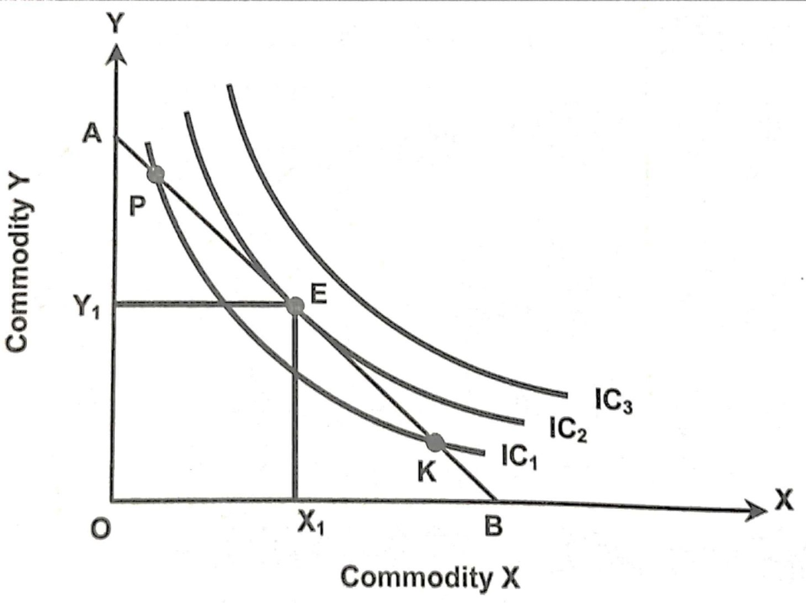

Point E is the equilibrium point which fulfill all the required conditions where AB budget line is tangent to IC2.
At point E,
Slope of Budget line=Slope of IC=$\frac{OY1}{OX1}$
IC2 is convex to origin as well.
Any point Below E gives low level of satisfaction where above is no attainable because of limited budget.

Slide 30
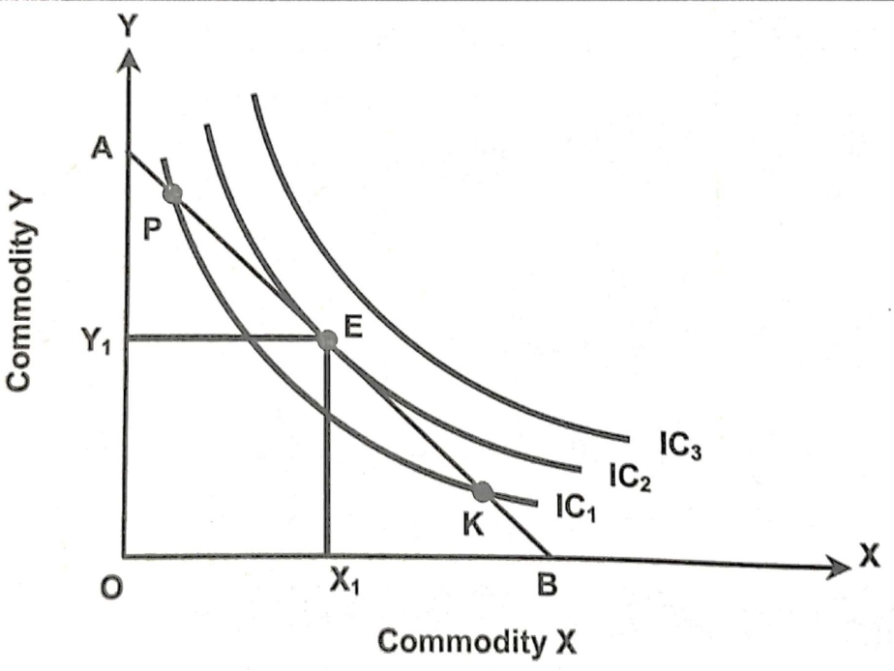
Why does consumer not attain equilibrium at higher IC i.e IC3?
Why does consumer not attain equilibrium at lower IC i.e IC1?
Why does consumer not attain equilibrium at intersect points between IC1 and AB budget line?

Slide 31
Income Effect(IE) on Equilibrium
Under ceteris paribus, the Income effect explains how the consumer reacts to changes in the income of the consumer.
If the income increases, the budget line shifts upward where the consumer will attain equilibrium at higher IC.
If the income decreases, the budget line shifts downward where the consumer will attain equilibrium at lower IC.
The Income Consumption Curve (ICC) is a curve relating to the balance point caused by the income change of consumers. It is obtained by joining the various equilibrium points.

Slide 32
Positive Income Effect
Income Effect on Normal Goods/Substitutable.
Income effect for a good is said to be positive when with the increase in income of the consumer, his consumption of the goods also increases and vice-versa.
ICC is the locus of equilibrium points at different levels of income showing various consumption levels.
ICC in this case is upward sloping which reflects the income effect in normal goods.
Notes:
Full page

Slide 33
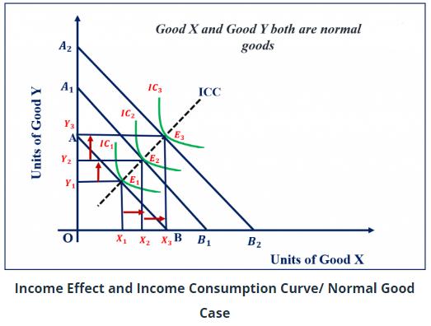
Notes:
When the income increases, consumption of goods also increases.
When the income decreases, consumption of the goods also decreases.
ICC in this case is upward-sloping

Slide 34
Negative Income Effect
Income effect on Inferior goods/Low-quality goods.
The income effect for a good is said to be negative when with the increases in his income, the consumer reduces his consumption of the inferior good.
This is because the goods whose consumption falls as the income of the consumer rises are considered to be in some way ‘inferior’ by the consumer and therefore he substitutes superior goods for them when his income rises.
ICC slopes backward from the left.

Slide 35
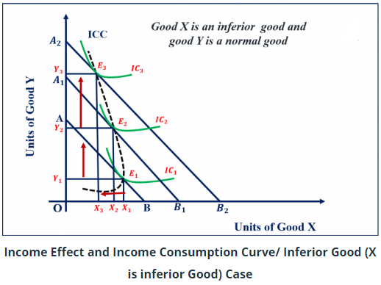
Notes:
when the income increases, the quantity of inferior goods decreases.
when the income decreases, the quantity of inferior goods increases.
ICC slopes backward from the left.

Slide 36
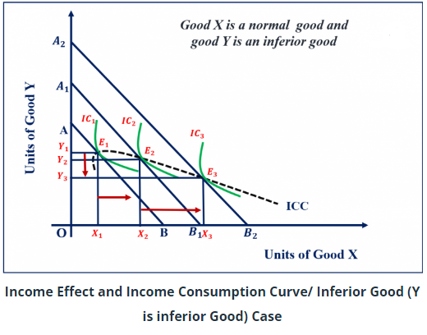
Notes:
when the income increases, the quantity of inferior goods decreases.
when the income decreases, the quantity of inferior goods increases.
ICC slopes backward from the left.

Slide 37
NO Income Effect
Income effect on Neutral goods.
The income effect for a good is said to be the No income effect when with the increases in his income, the consumer does not change his consumption of the good.
ICC is parallel to the axes opposite to the neutral goods.

Slide 38
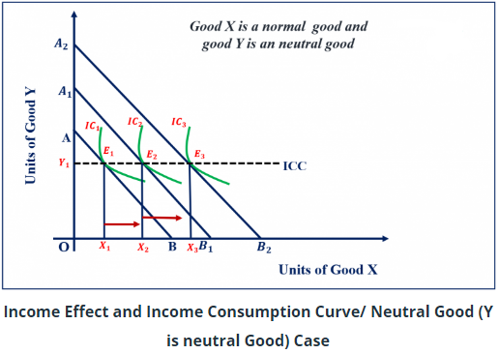
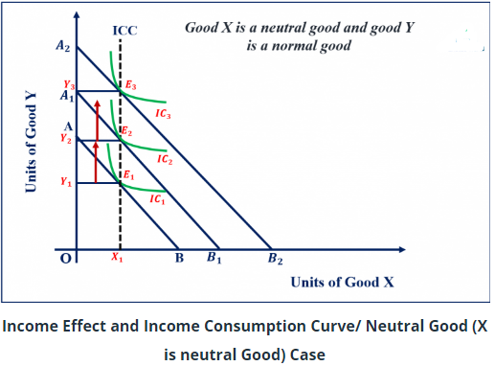
No Income Effect
No Income Effect

Slide 39
Price Effect on Equilibrium
Under ceteris paribus, the Price effect explains how the consumer reacts to a change in the price of a commodity.
If the price of goods falls, the real income of the consumer increases, and a new equilibrium point is obtained at a higher IC.
If the price of goods increases, the real income of the consumer decreases and a new equilibrium point is obtained at a lower IC.
PCC is a curve relating to the balancing point caused by the change in price.
The price-consumption curve (PCC) indicates the various amounts of a commodity bought by a consumer when its price changes.

Slide 40
Negative price effect
Price Effect (PE) on Normal goods/ Substituable goods.
There is an inverse relationship between price and quantity in the case of normal goods.
If the price of normal goods falls, the quantity demanded increases and vice-versa.
PCC is downward sloping reflecting the negative price effect.

Slide 41
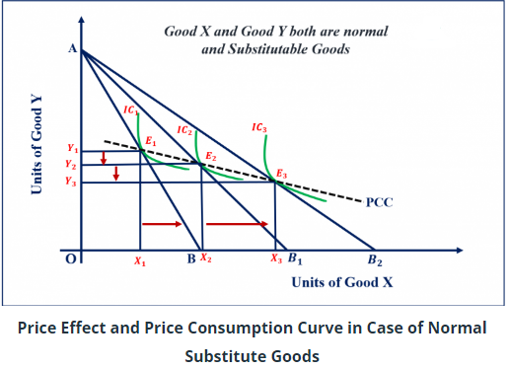
Price Effect (PE) on Normal goods
Notes:
If the price of normal goods falls, the quantity demanded increases.
IF the price of normal goods rises, the quantity demanded decreases.
PCC is downward sloping reflecting the negative price effect.

Slide 42
Positive Price Effect
Price effect on Giffen goods.
The goods that increase consumption as the price increases are known as the Giffen good.
There is a positive relation between the price and demand of Giffen goods.
If the price of Giffen goods falls, the demand for it also falls but the demand for normal goods rises.
If the price of Giffen goods rises, the demand for it also rises but the demand for normal goods falls.
PCC is backward bending when the price of Giffen goods decreases.

Slide 43
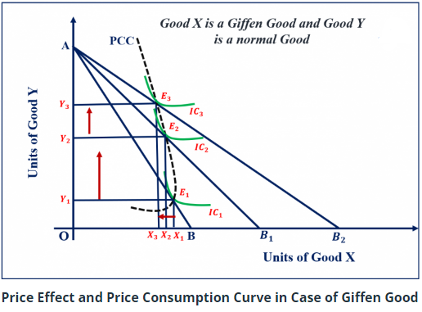
Price Effect (PE) on Giffen goods
Notes:
If the price of Giffen goods falls, the demand for it also falls but the demand for normal goods rises.
If the price of Giffen goods rises, the demand for it also rises but the demand for normal goods falls
PCC is backward bending when the price of Giffen goods decreases

Slide 44
Price Effect (PE) on Complementary goods
There is an inverse relationship between price and quantity in the case of complementary goods.
If the price of one good falls then the demand for other related goods will increase.
If the price of one good rises then the demand for other related goods will decrease.
PCC is upward-sloping in the case of complementary goods.

Slide 45
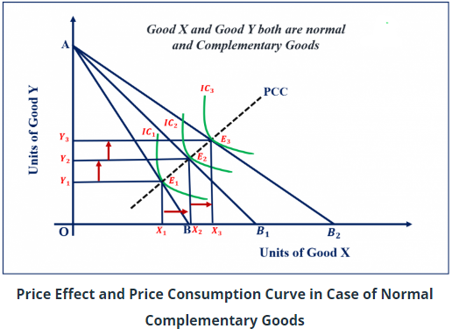
Price Effect (PE) on Complementary goods
Notes:
If the price of one good falls then the demand for other related goods will increase.
If the price of one good rises then the demand for other related goods will decrease.
PCC is upward-sloping in the case of complementary goods.

Slide 46
Substitution Effect on Equilibrium
In our situation of good X, good Y, and money income M; if money income and the price of good Y stay the same but the price of good X rises, then the consumer will feel poorer, and if the price of good X falls, then the consumer will feel richer. This observation has led economists to try to separate the impact of a price change on the quantity demanded into two components.
The substitution effect:
It involves the substitution of good X for good Y or vice-versa due to a change in the relative price of two goods.
The income effect:
It involves the change in demand for the goods due to an increase or decrease in the consumer's real income or purchasing power as a result of the price change.

Slide 47
Substitution Effect on Equilibrium
The sum of these two effects is often called the total effect of a price change or simply the price effect. The decomposition of the price effect into the substitution and income effect components (Income and Substitution Effects of a Price Change) can be done in several ways depending on what we would like to hold constant.

Slide 48
Substitution Effect on Equilibrium
The substitution effect is the change in quantity demanded of a commodity due to a change in its relative price alone, with the real income of the consumer remaining the same. It means SE is the change in quantity demanded of a commodity due to a change in the relative price of the same commodity keeping the real income and price of other goods constant.
Therefore, SE relates to the change in the quantity demand resulting from a change in the relative price of the goods.
According to Dominick Salvatore, the substitution effect measures the increase in the quantity demanded of a good when its price falls resulting only from the relative price decline and independent of the change in real income.

Slide 49
Substitution Effect on Equilibrium
For example,
SE relates to the increase in the quantity demand of good X when its price falls while keeping the real income and price of Y remain constant.
In such cases the consumer substitutes cheaper goods X for the relatively dearer goods Y When there is a fall in the price of good x, the real income of the consumer will increase but an increase in real income of the consumer is maintained constant to see the substitution effect.

Slide 50
Substitution Effect on Equilibrium
When there is a change in the price of a commodity then there is a change in demand. Here demand changes due to two reasons as;
One is that the commodity now becomes relatively cheaper or expensive/dearer and demand will be affected.
Second is that when there is a change in price then the purchasing power also changes and as a result, there is a change in demand.

Slide 51
Substitution Effect on Equilibrium
And now suppose the price has declined then:
The commodity will become cheaper and the consumer will buy more of it by substituting cheaper for dearer/expensive. It is called the substitution effect. Likewise, with a fall in price, there is an increase in real income or purchasing power so demand will be increased. It is called the income effect,
Therefore,
Total Price Effect=Substitution Effect + Income Effect (PE=SE+IE)
Thus, the substitution effect is the change in demand for a commodity due to a change in its relative price only, keeping the real purchasing power constant.

Slide 52
Hicksian Approach
In this approach, the money income of the consumer is changed by an amount which keeps the consumer in the initial level of satisfaction at the same IC as he was in equilibrium before the change in the price.
The amount by which the money income of the consumer stays in the same IC is called compensating variations in income.
In other words, compensating variation in income is a change in the income of the consumer which is just sufficient to compensate the consumer for a change in the price of a good.

Slide 53
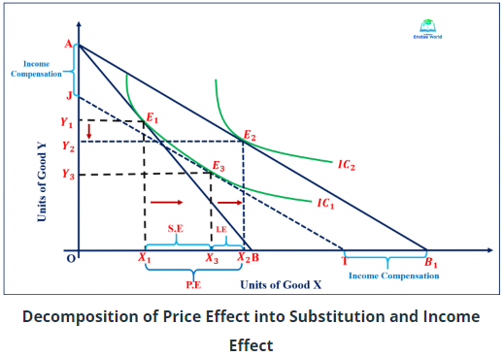
Hicksian Approach

Slide 54
Slutsky Approach
A Soviet economist, Eugen Slutsky had proposed an alternative definition of the substitution effect, similar to the Hicksian substitution effect.
In the Sulstky method, the increased income due to a fall in price is adjusted or compensated so that the consumer can be on the original or the old indifference curve at the new set of prices.
Thus, Slutsky's substitution effect is derived when the income adjustment is such that the consumer can buy the old bundle at the new set of prices. This method is also known as the cost difference method.

Slide 55
Slutsky Approach
In this approach, the consumer’s income has to be so changed that the consumer returns not only to his/her original IC but also to the original point of equilibrium.
In other words, the income of the consumer is changed in such a way that the consumer can purchase the original combination of the two goods if he so desires.
The consumer’s income-adjusted budget line must pass through the initial equilibrium point on the original IC.

Slide 56
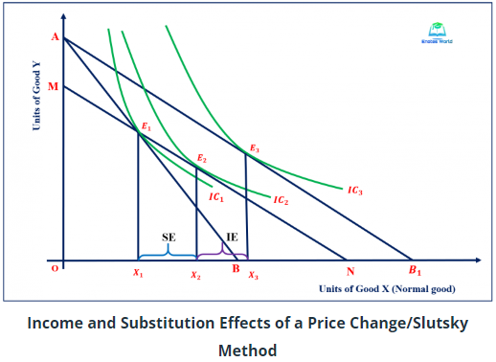
Slutsky Approach

Slide 57
https://enotesworld.com/income-and-substitution-effects-of-a-price-change/

Slide 58
Why does MRS diminish?
1. Changes in Intensity of wants.
The diminishing marginal rate of substitution is a result of the fact that people have different preferences and values for different goods and the value they place on each good changes as they consume more or less of it.
2. Imperfect substitution.
Goods are not perfectly substitutable. It means giving one unit of other goods does not mean adding one unit of the other, it may require more of one for other.
3. An increase in the quantity of one good does not imply an increase in the want satisfying of the other.

